Slide 1
Real estate prices in Toronto
FINTECH PROJECT 1
GROUP 2:
FANTASIC FIVE

Slide 2
Contents
Purpose and Summary - Ali
Data Cleaning - Ameer
Data Analysis – City of Toronto - Ameer
Data Analysis – By Neighborhoods - Javier
Projection – Toronto and Neighborhoods - Haider
Snapshot – Real Estate Prices by location - Tejas
Conclusion and Recommendation - Ali

Slide 3

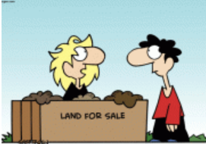
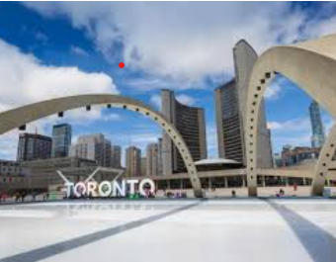
PURPOSE AND SUMMARY
TORONTO MARKET HYPE
WHY TORONTO ?
CHANGING MARKET TRENDS
CORONA VS GLOBAL WARMING
FINDING THE RIGHT INVESTMENT
PAST VS PRESENT VALUE & FUTURE UNCERTAINETIES

Slide 4
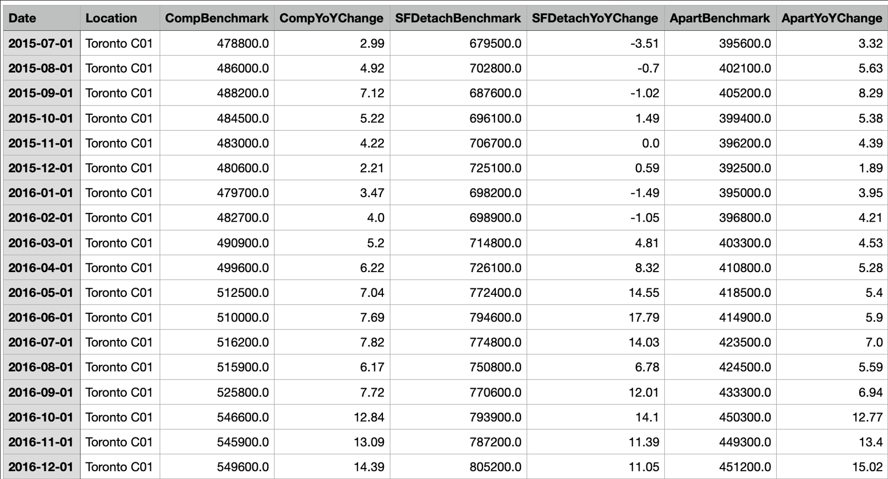
DATA CLEANING
TRREB DOES NOT PROVIDE MLS APIs FOR PUBLIC USE.
USED KAGGLE TO FIND OUR DATABASE CONSISTING OF OVER 75,000 DATA POINTS FOR ALL OF ONTARIO.
ANALYSIS CONDUCTED ON TORONTO MLS SUBDIVISIONS, C01 to C15
USED COMPOSITE, SF-DETACHED, & APARTMENT/CONDOS FOR
GIVEN ANALYSIS

Slide 5
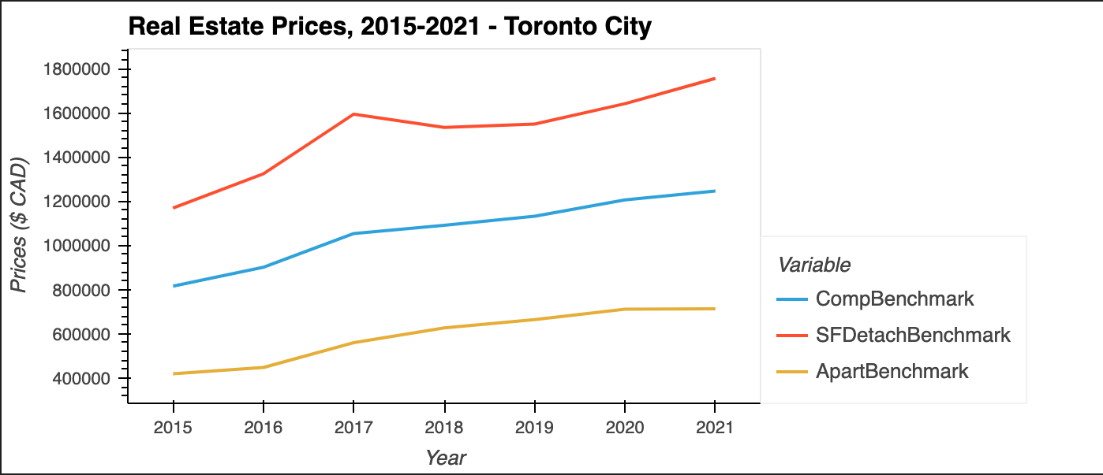
Data Analysis – City of Toronto - Graph

Slide 6
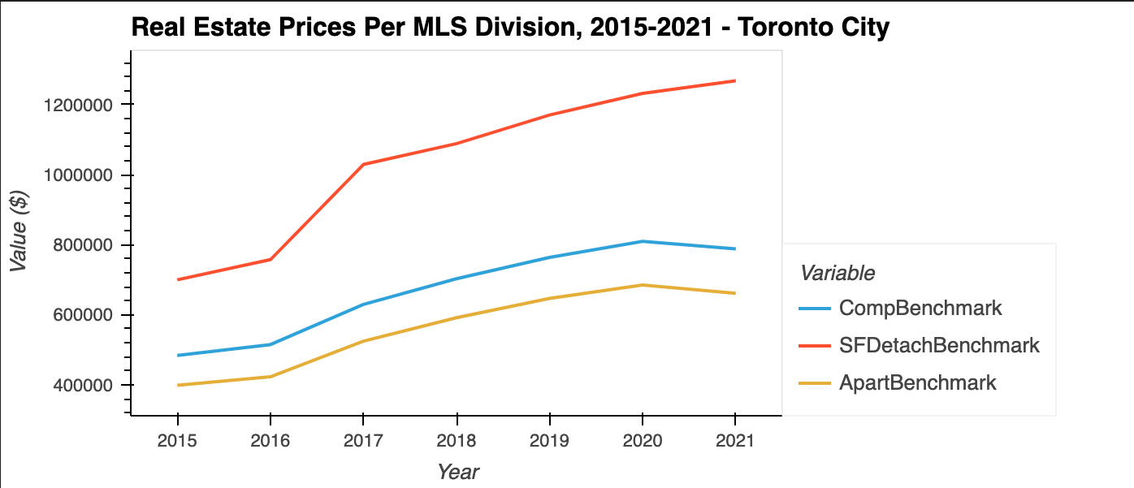
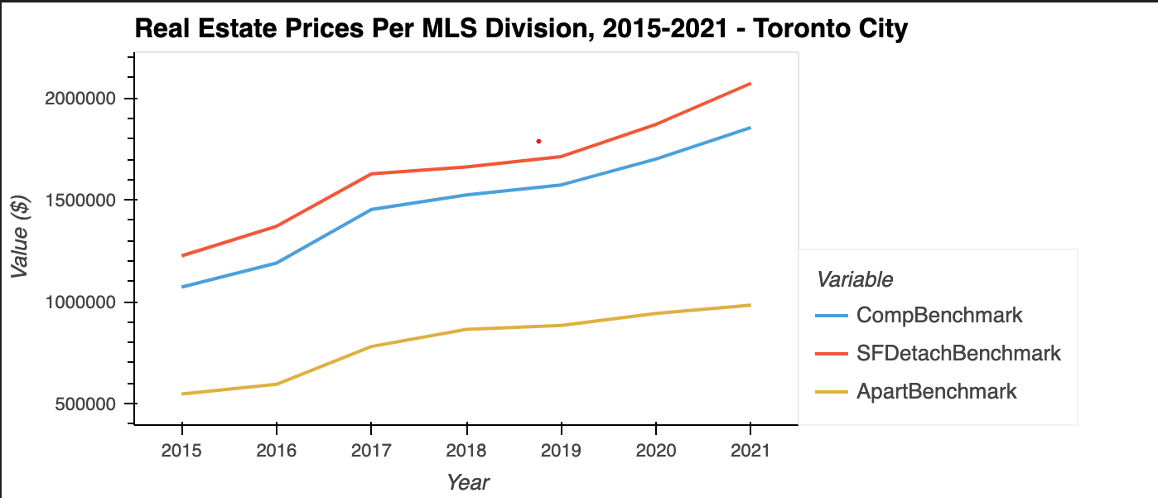
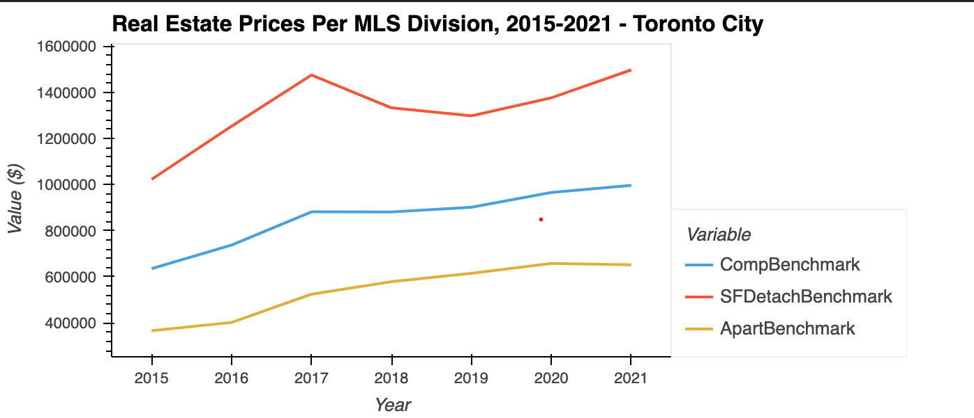
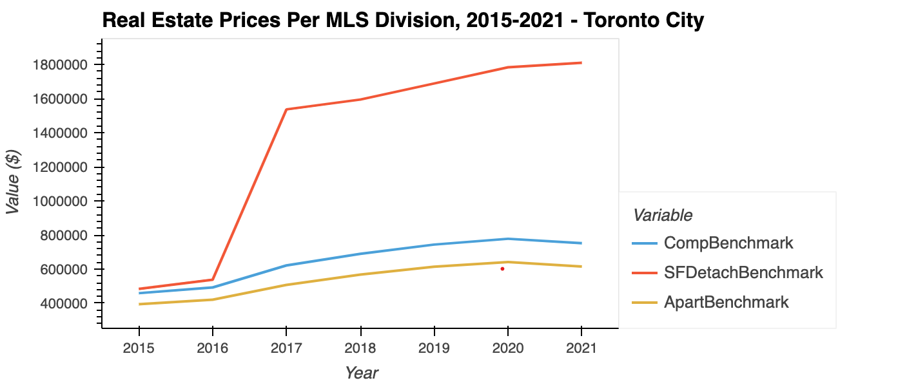
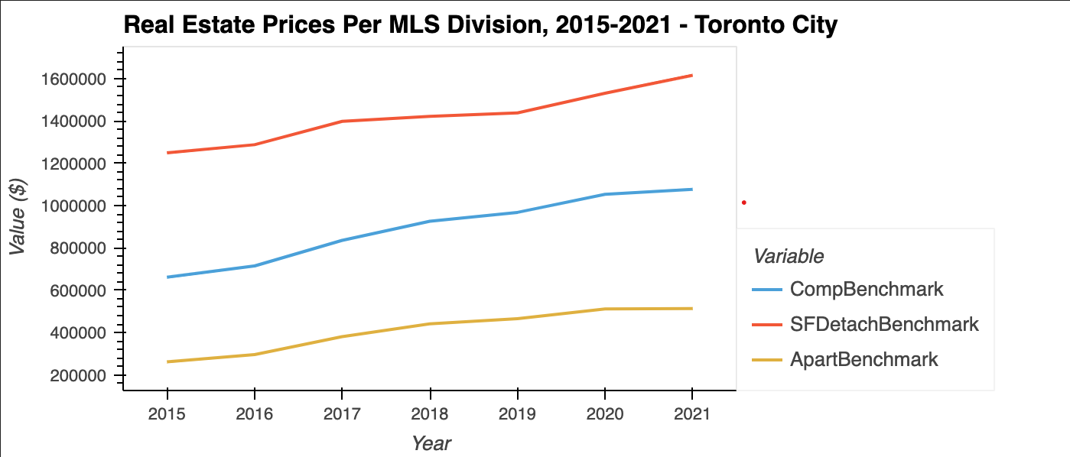
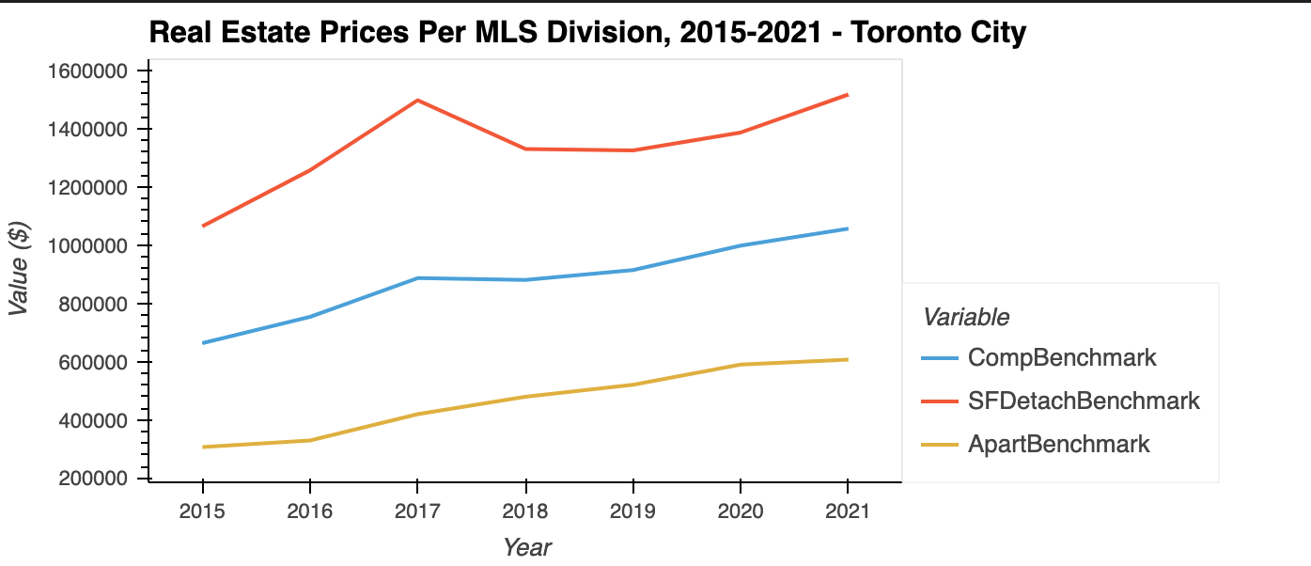
Data Analysis – By Neighborhoods - Graph

Slide 7
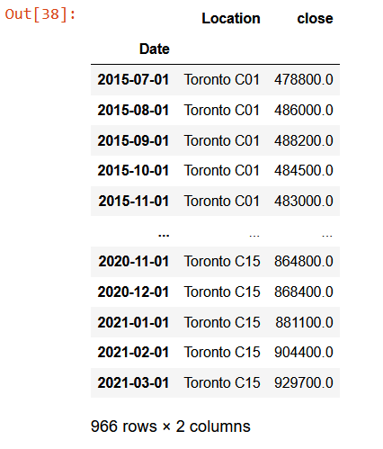
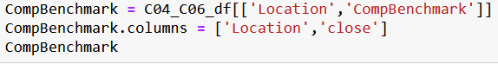
Projection – Toronto and Neighborhoods - Graph

Slide 8
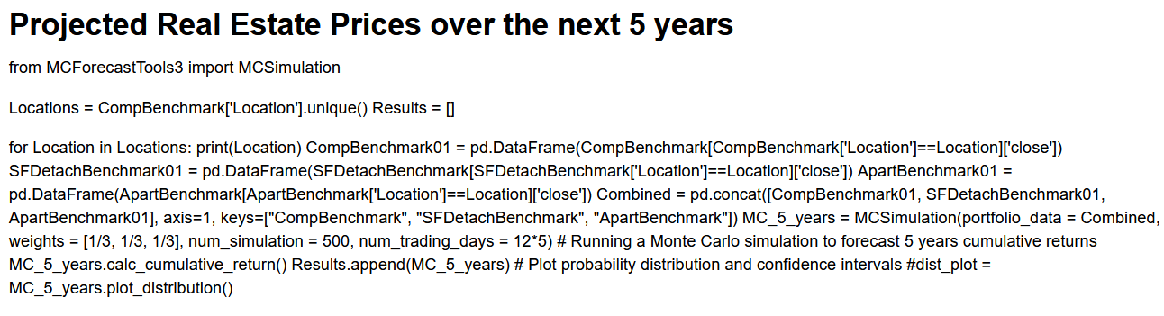
coding the simulation and plots

Slide 9
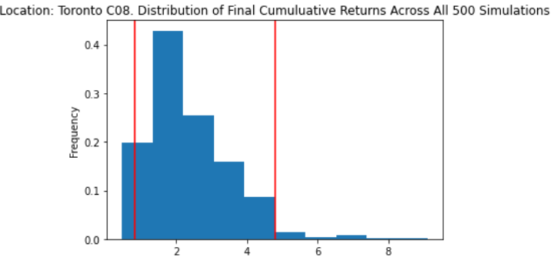
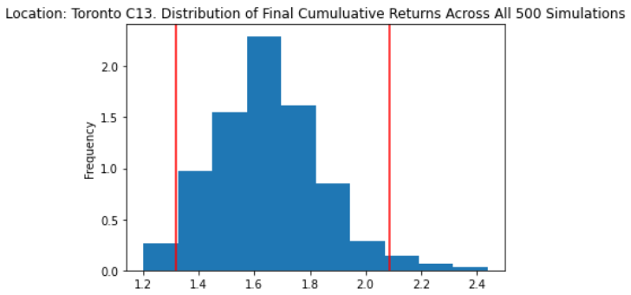
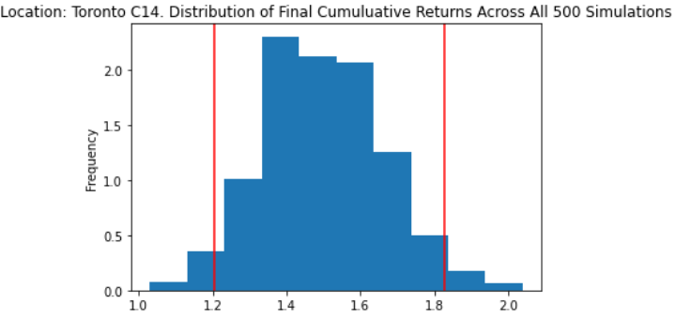
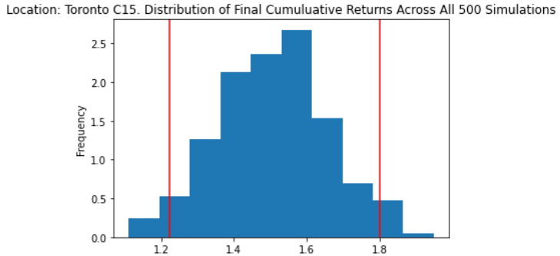
Projected price Results
Notes:
Price Increase in C08 is largely due to the increase in Detached Houses (not apartments). In one year the average price went from $500K to nearly $1.5 Million

Slide 10
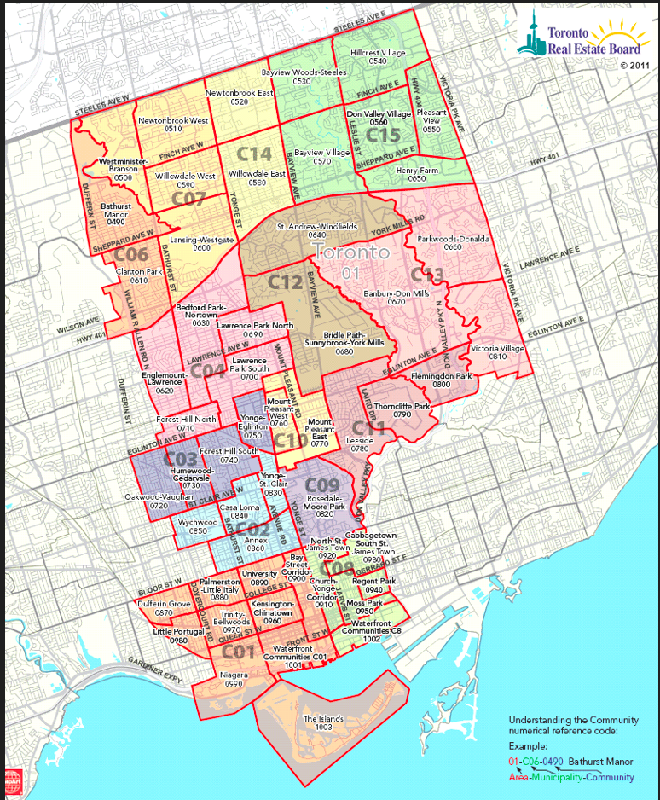
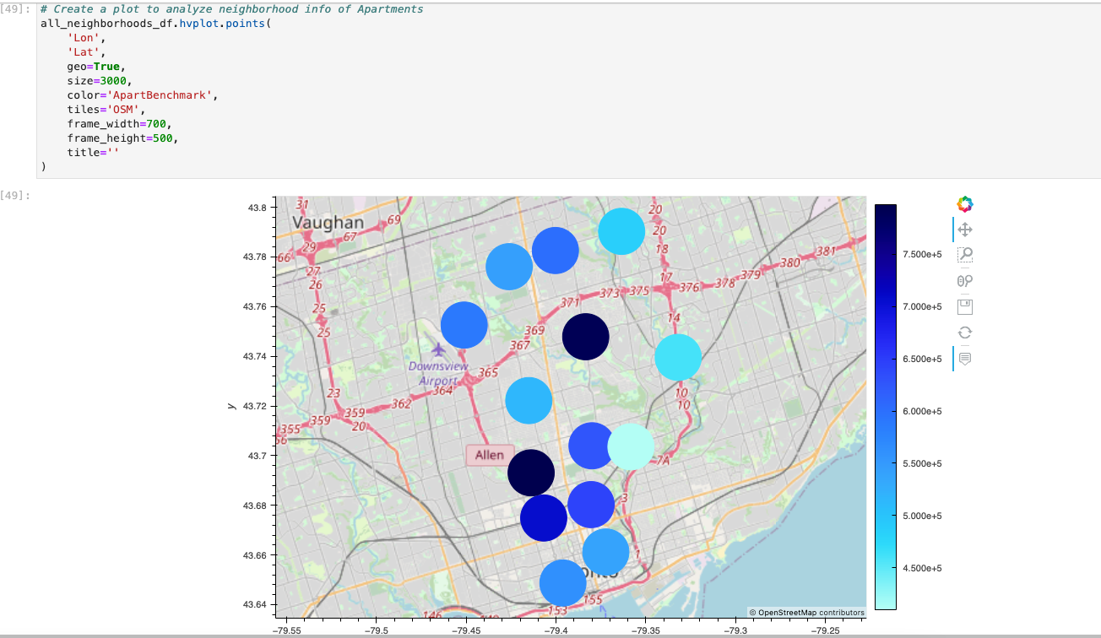
Snapshot – Real Estate Prices by location - Graph

Slide 11
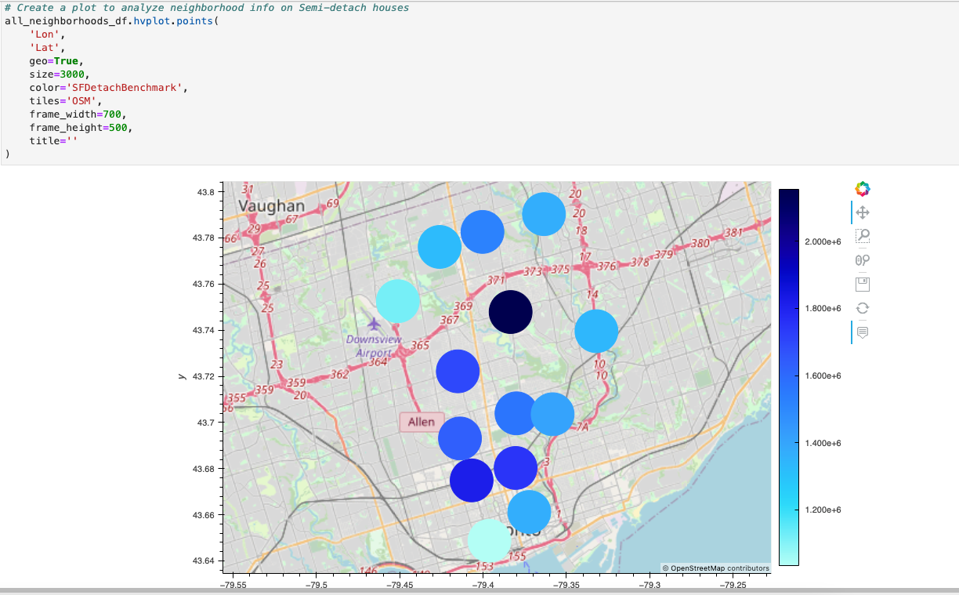
Snapshot – Real Estate Prices by location - Graph

Slide 12
Conclusion and recommendation

